Slide 1
Predicting Mortality in the CRRT Population
David Sasson, Christopher V. Cosgriff, Colby Wilkinson, Kanhua Yin
MS Candidate, Health Data Science
Harvard T.H. Chan School of Public Health
Big Data For Health, Diliman, Quezon City
July 10-11 2018

Slide 2
I’m from Brooklyn
“NYC is the best city in the world” – every New Yorker

Slide 3

Thanks for inviting me
Pinoys know to live!

Slide 4
Background: CRRT
Continuous renal replacement therapy (CRRT) is a renal replacement strategy that is commonly required for patients with acute kidney injury (AKI)
hemofiltration, hemodialysis, and hemodiafiltration
Both AKI and CRRT are associated with high (40 to 60%) in-hospital mortality
Known risk factors of mortality include
older age, male sex, sepsis, respiratory or liver failure, low platelet level, and overall severity of the disease (APACHE score)
We need an approach to accurately predict the short-term mortality of CRRT for ICU patients through common lab or clinical examination results

Slide 5
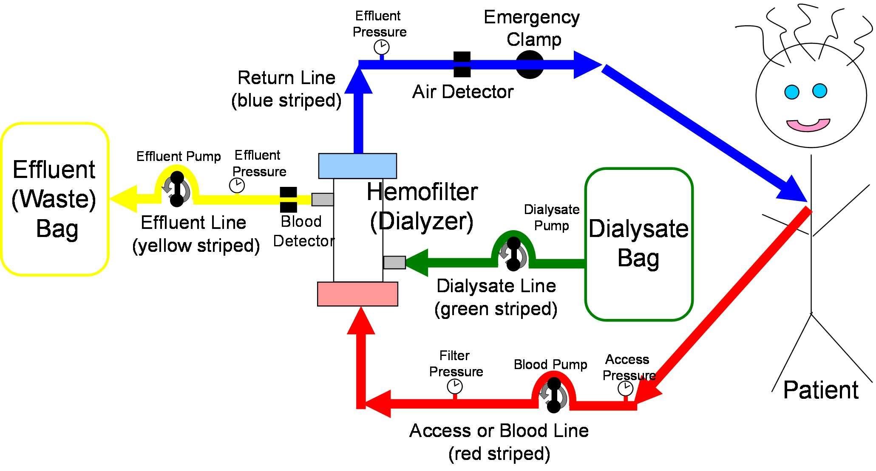

Slide 6
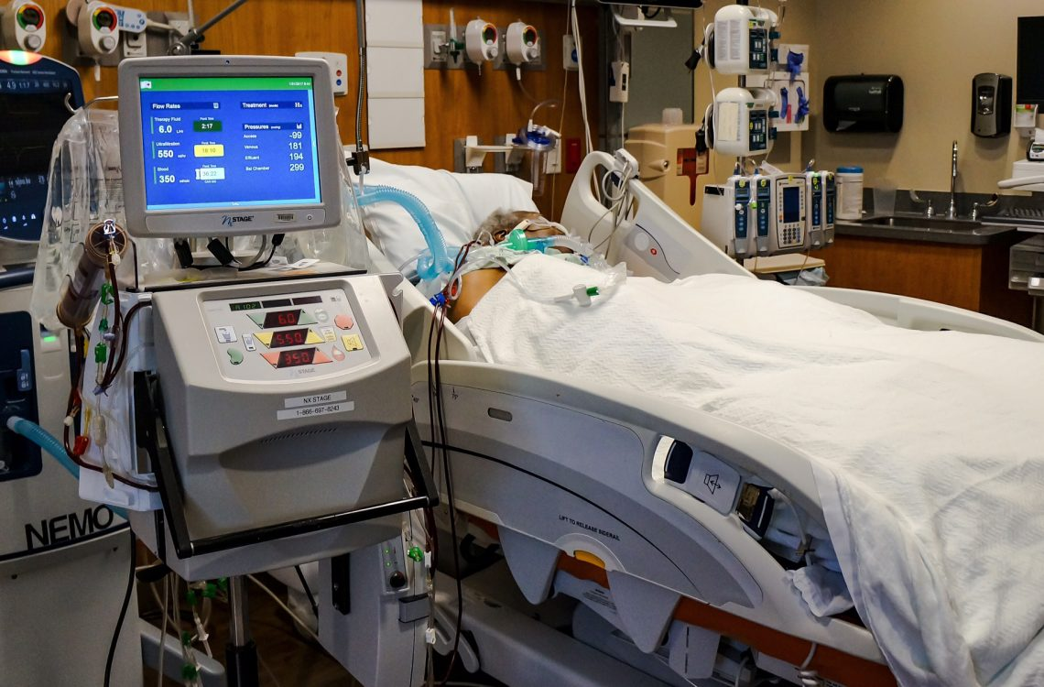

Slide 7
Medical Information Mart for Intensive Care (MIMIC-III)
MIMIC-III is an ICU database with ~50,000 ICU stays from BIDMC
Open access data base created by the MIT Laboratory for Computational Physiology
Deidentified data that can be used for descriptive, predictive, and causal inference studies
Generates ~3 papers/month

Slide 8
Tools
Software
Keras on Tensorflow backend (Python 3.6)
Google Compute Cloud
Hardware
Tesla K80 GPU
Github
github.com/cosgriffc/bst261-crrt
Architecture
GRU + 4 layered RNN with dropout

Slide 9
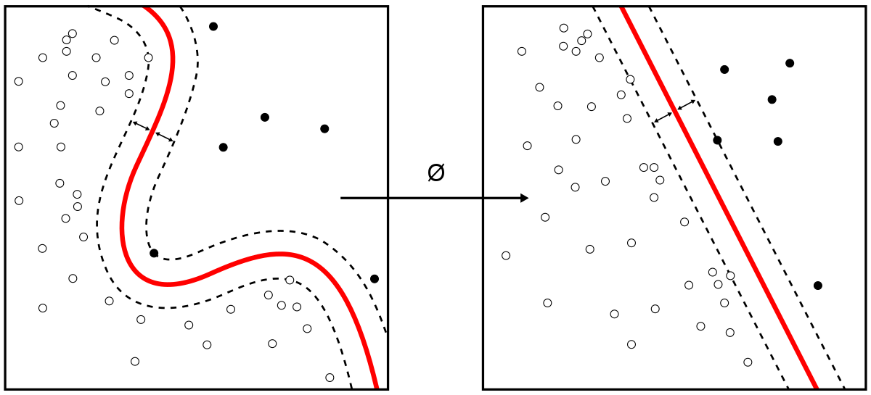
Caveat
I did this for a final project last semester
2 weeks
lots of coffee
Not publication ready
Barely useable for public consumption
Here we go…

Slide 10
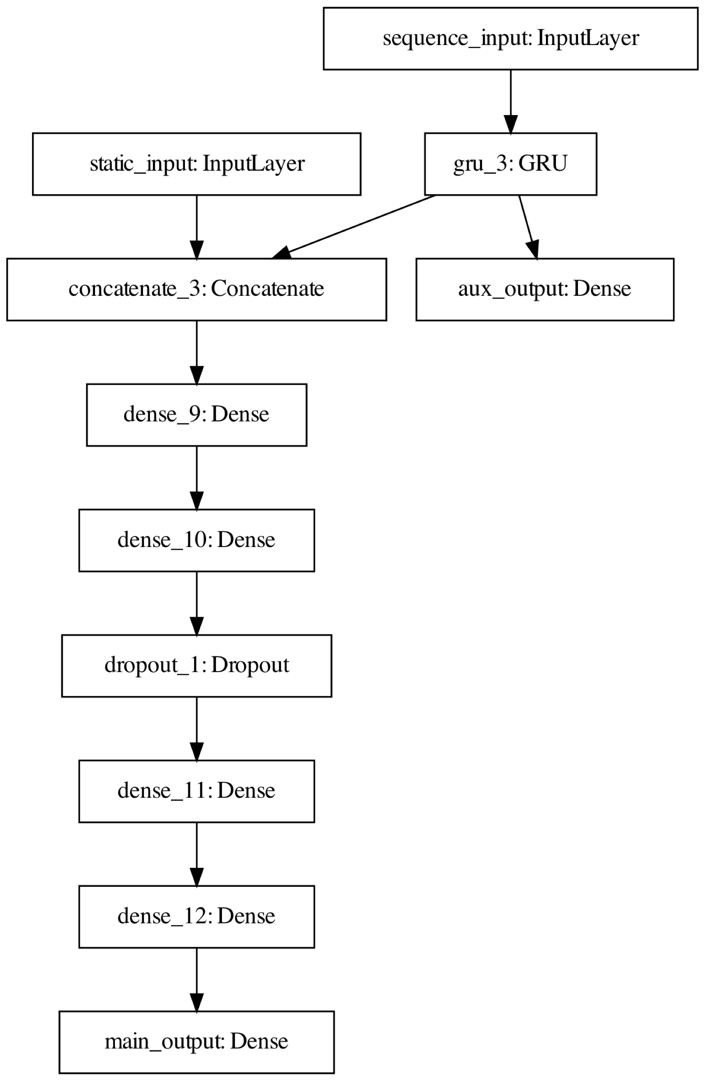

Slide 11
Model Architecture & Optimization
Dataset was split into training and validation sets
Trained a general recurrent unit (GRU) and recurrent neural network (RNN)
Experimented with dropout
Both set to 10%
Two data types
Static: from beginning of stay in ICU
Sequential: from last day in ICU
Time-series data was input to the GRU
Local loss function - trained smoothly instead of relying on total loss of full model
automated feature extraction
Both data were merged and fed into a densely connected feedforward network.
Optimizer: rmsprop, LR: 0.00001

Slide 12
Who actually understood what that meant?
me neither
I did undergrad in Biochemistry
my cohort is full of Applied Math & Stats people
I learned all of this in a year
if less people understand data science
market stays hungry for talent
data scientists remain employed and well paid
yes data science is hard, but for good reason
once you have have this skill set you can work on any problem, disease, or person relating to data

Slide 13
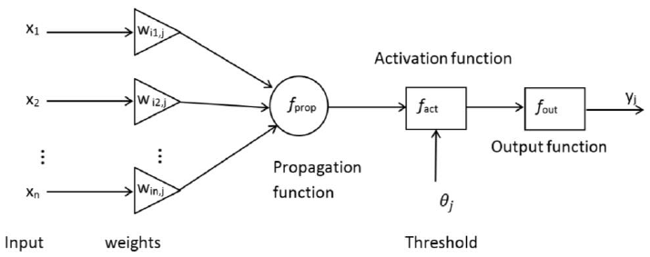
”Artificial Intelligence”

Slide 14
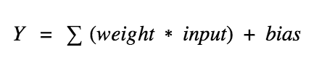
Neurons
So what does an artificial neuron do?
It calculates a “weighted sum” of its input, adds a bias and then decides whether it should be “fired” or not

Slide 15


Slide 16
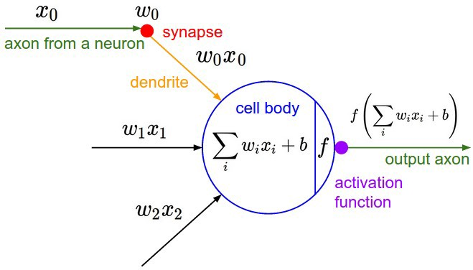

Slide 17
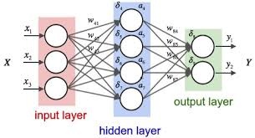
Dense Layers
linked connections between artificial neurons

Slide 18

Dropout
percentage of how much of the model to randomly kill off

Slide 19


Slide 20
WTF is a GRU?
“Gated Recurrent Units (GRU) are a variation on Long Short Term Memory (LSTM) recurrent neural networks. Both LSTM and GRU networks have additional parameters that control when and how their memory is updated. Both GRU and LSTM networks can capture both long and short term dependencies in sequences, but GRU networks involve less parameters and so are faster to train. Conceptually, a GRU network has a reset and forget "gate" that helps ensure its memory doesn't get taken over by tracking short term dependencies. The network learns how to use its gates to protect its memory so that it's able to make longer term predictions.”

Slide 21
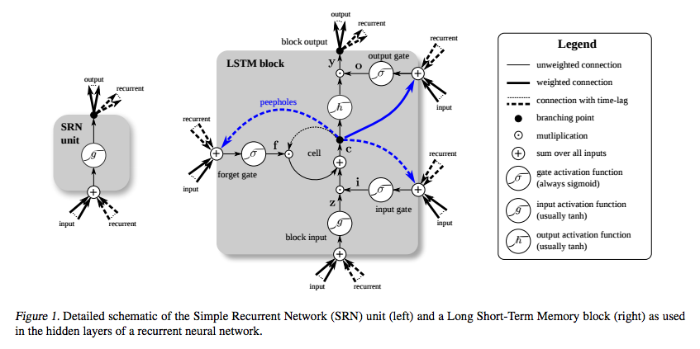
This is not helpful

Slide 22
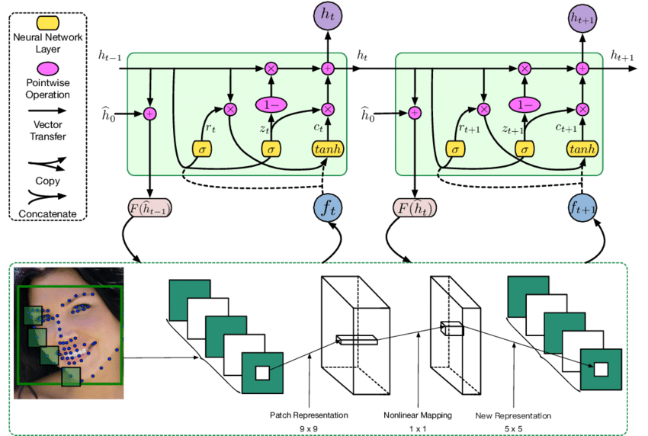
Getting better

Slide 23
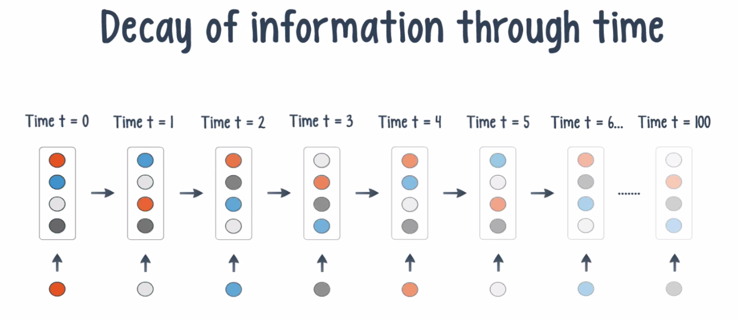
Reframe the question
Why do they exist?
Solution to the Vanishing Gradient Problem
For more info see Ian Longfellow’s book on Deep Learning

Slide 24
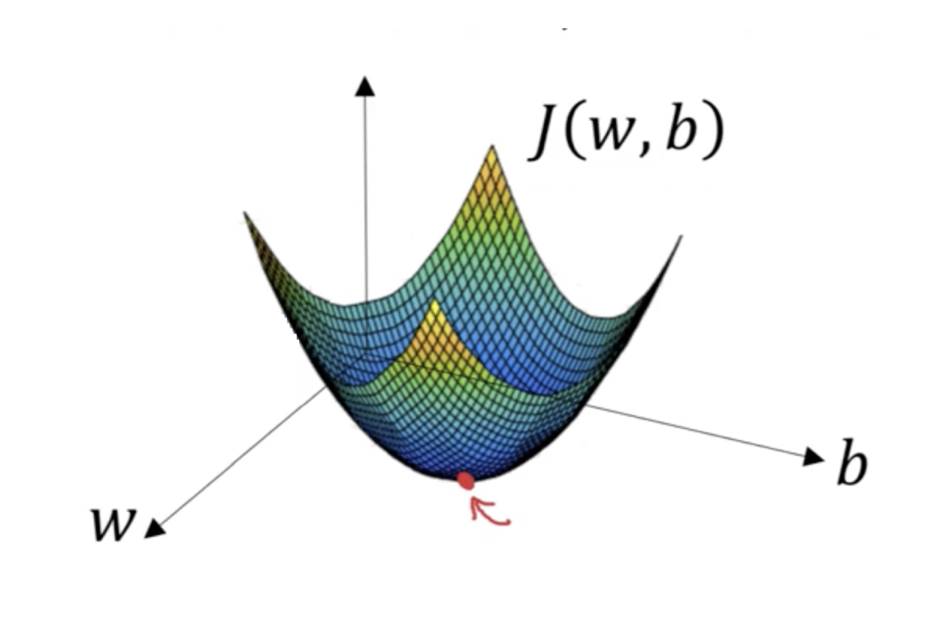
Calculus!
”Stochastic Gradient Descent”
Going down a math mountain randomly

Slide 25
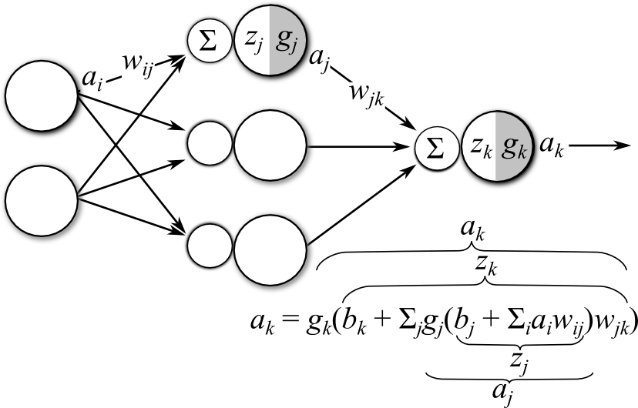
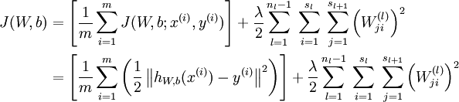
This is disgusting

Slide 26
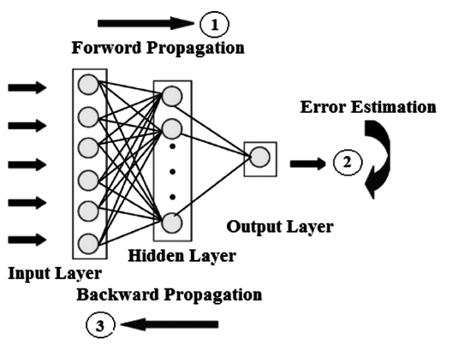
Back-propagation

Slide 27
Back-propagation
moving backward in the network
updating weights
as we keep on adding hidden layers
the learning speed of network is faster
calculating gradients of loss (error) with respect to the weights is faster
neurons in earlier layers learn slower than layers closer to the output
earlier layers in the network are slowest to train
each weight gradient tend to get smaller and smaller as we keep on moving backward in the network

Slide 28
Artificial Intelligence

Slide 29
Cohort
Exclude patients <16 years of age
1,301 ICU stays
Test set was 20% of data
Remaining 80% further split into train/validation 90%/10%

Slide 30
Feature Extraction
Static: Direct pull from materialized views
Demographics
Baseline illness severity on day 1 (OASIS score)
Baseline comorbidity (Elixhauser score)
Vasopressors given?
Ventilation given?
Sequence: Custom built pipeline
Vitals: HR, RR, SBP, DBP, MAP, SpO2
Labs: CBC, comprehensive metabolic
Resampled to 1 hour for previous 24 hours

Slide 31
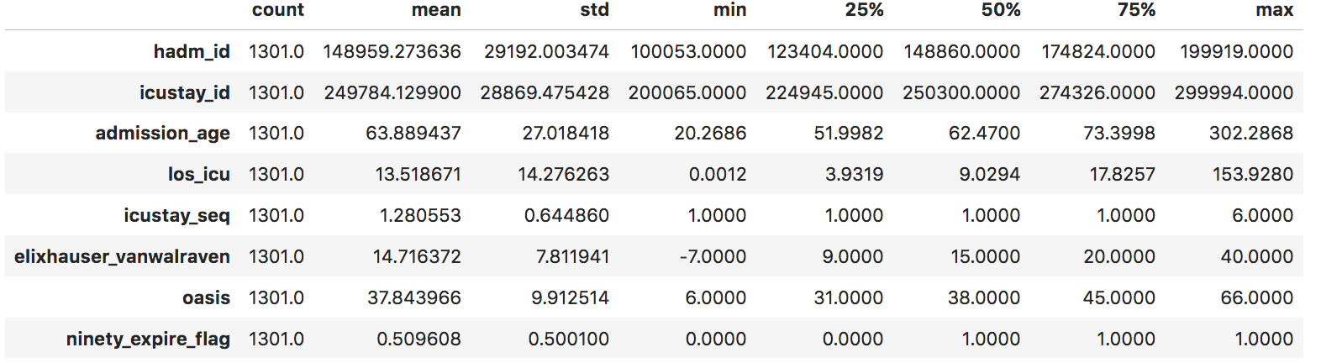
Descriptive Statistics for Static Features

Slide 32
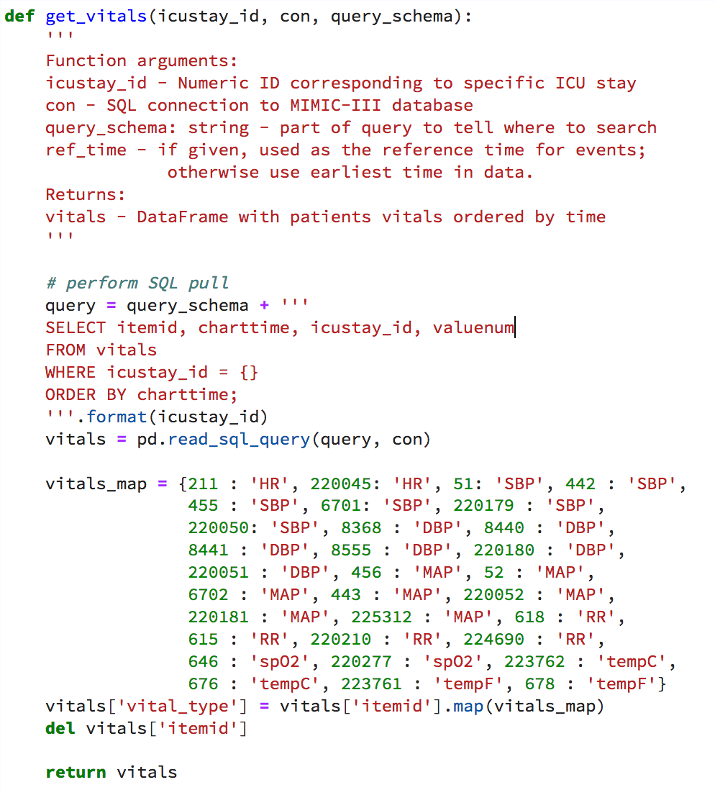
Feature Extraction

Slide 33
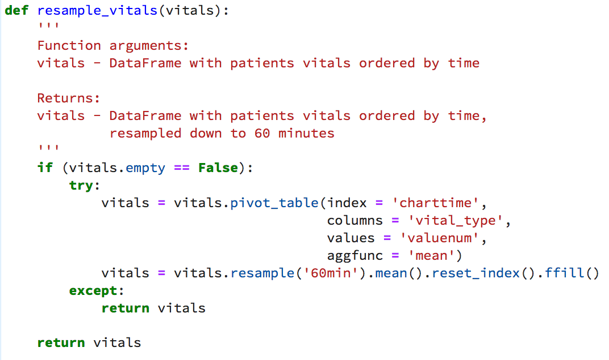
Feature Extraction

Slide 34
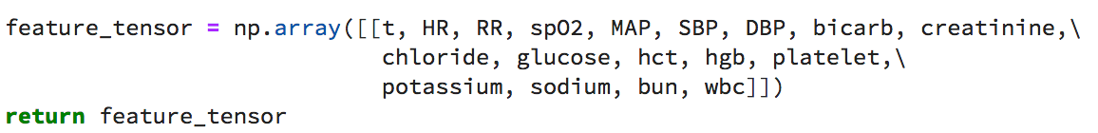
Feature Extraction

Slide 35
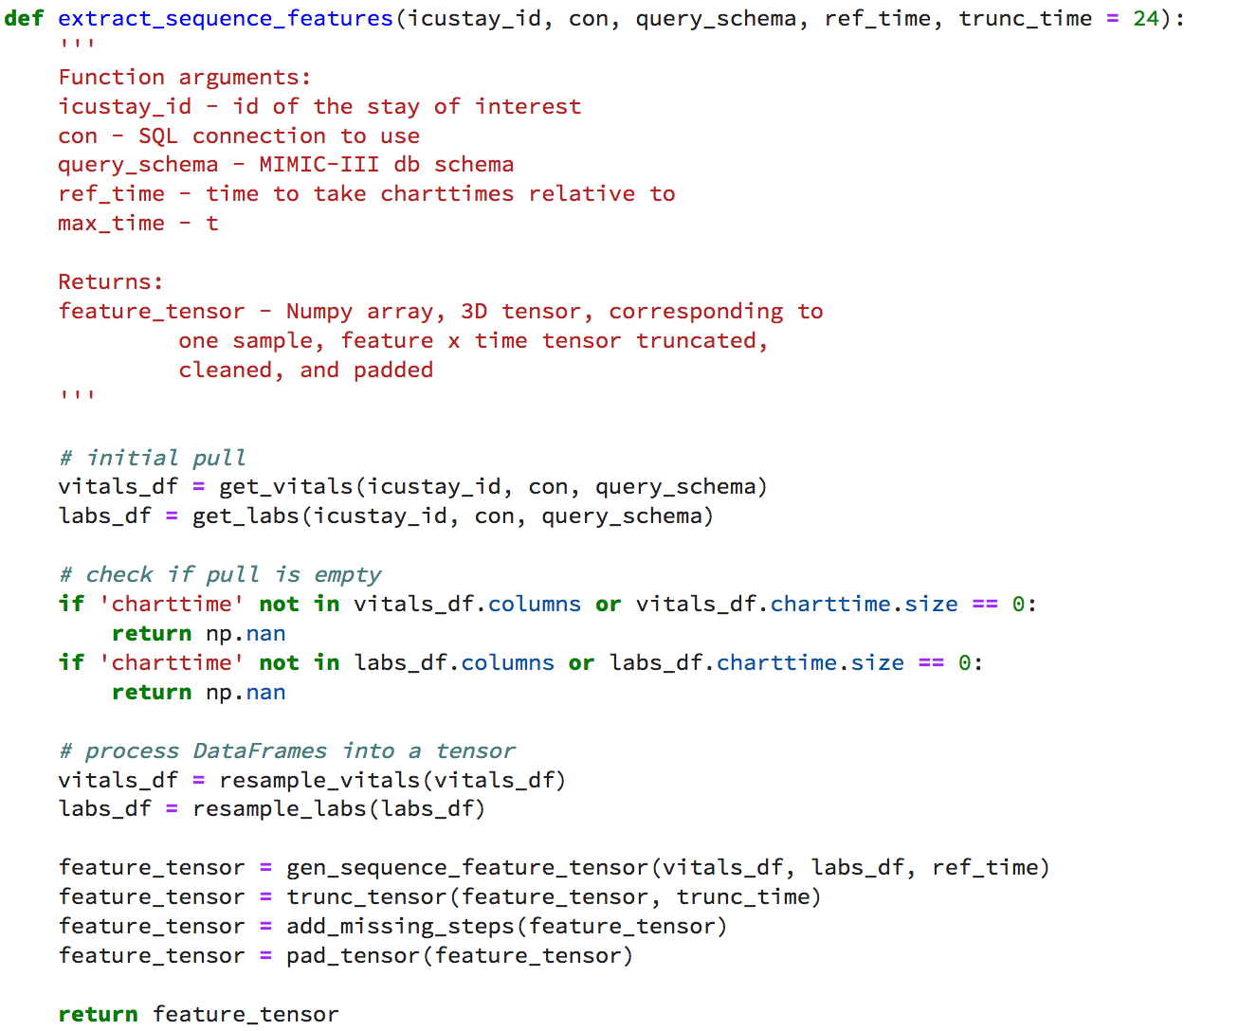
Features

Slide 36
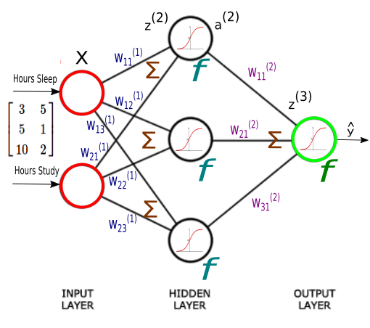

Slide 37
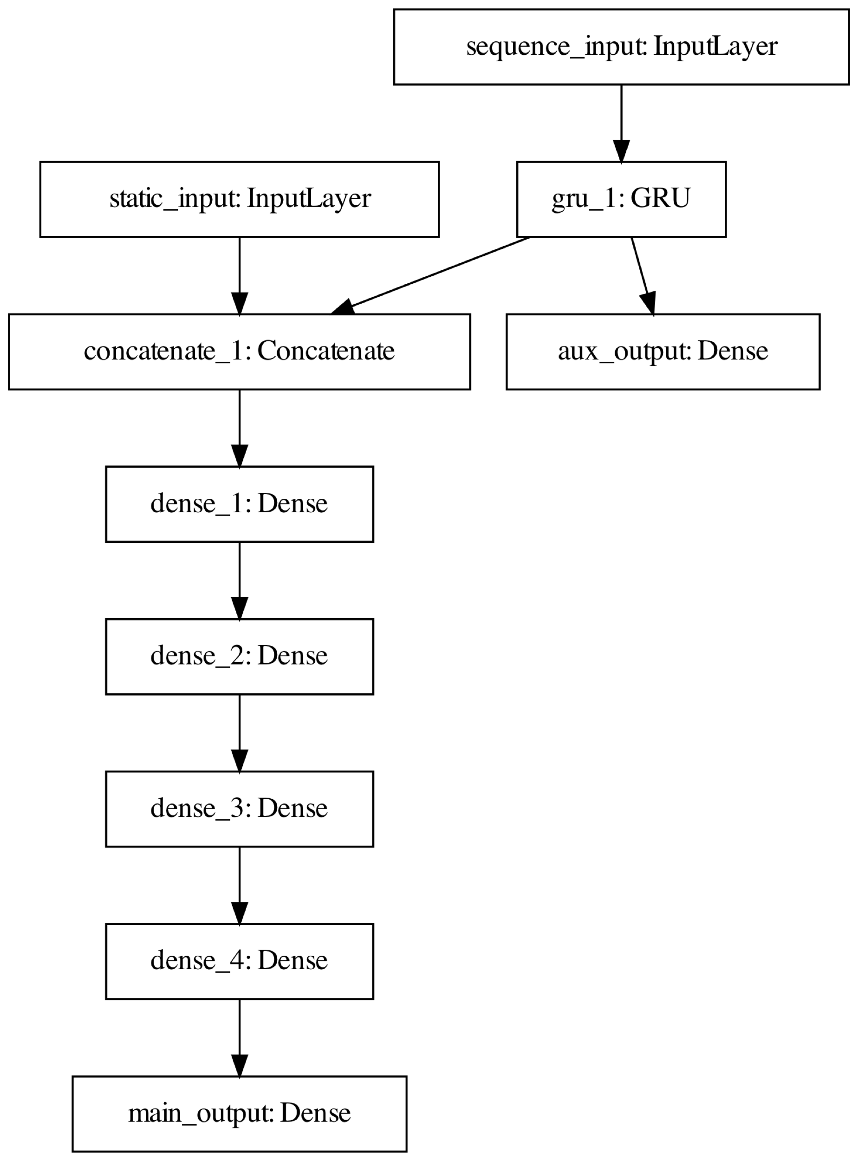

Slide 39
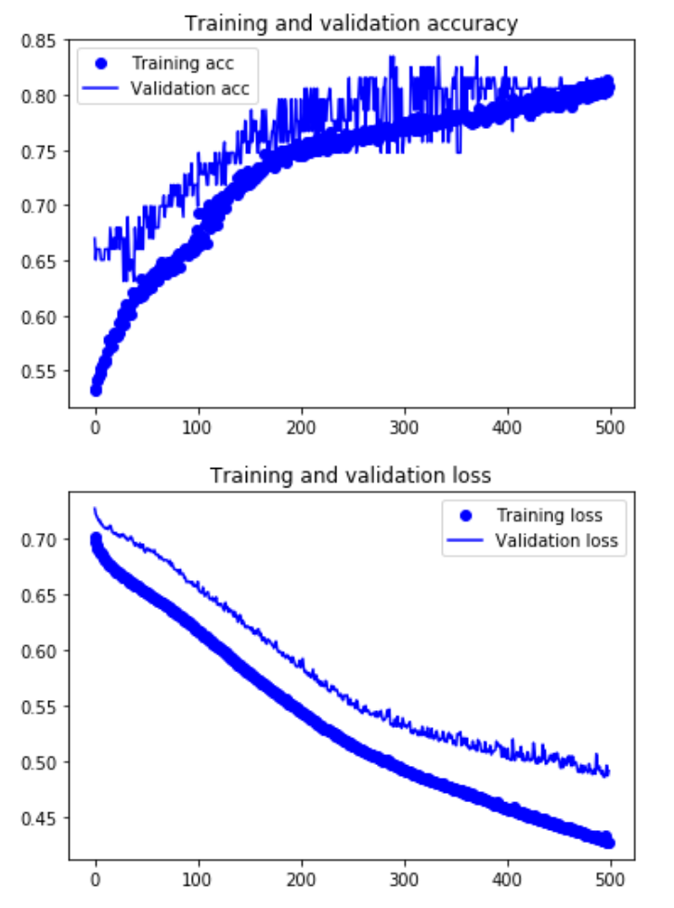
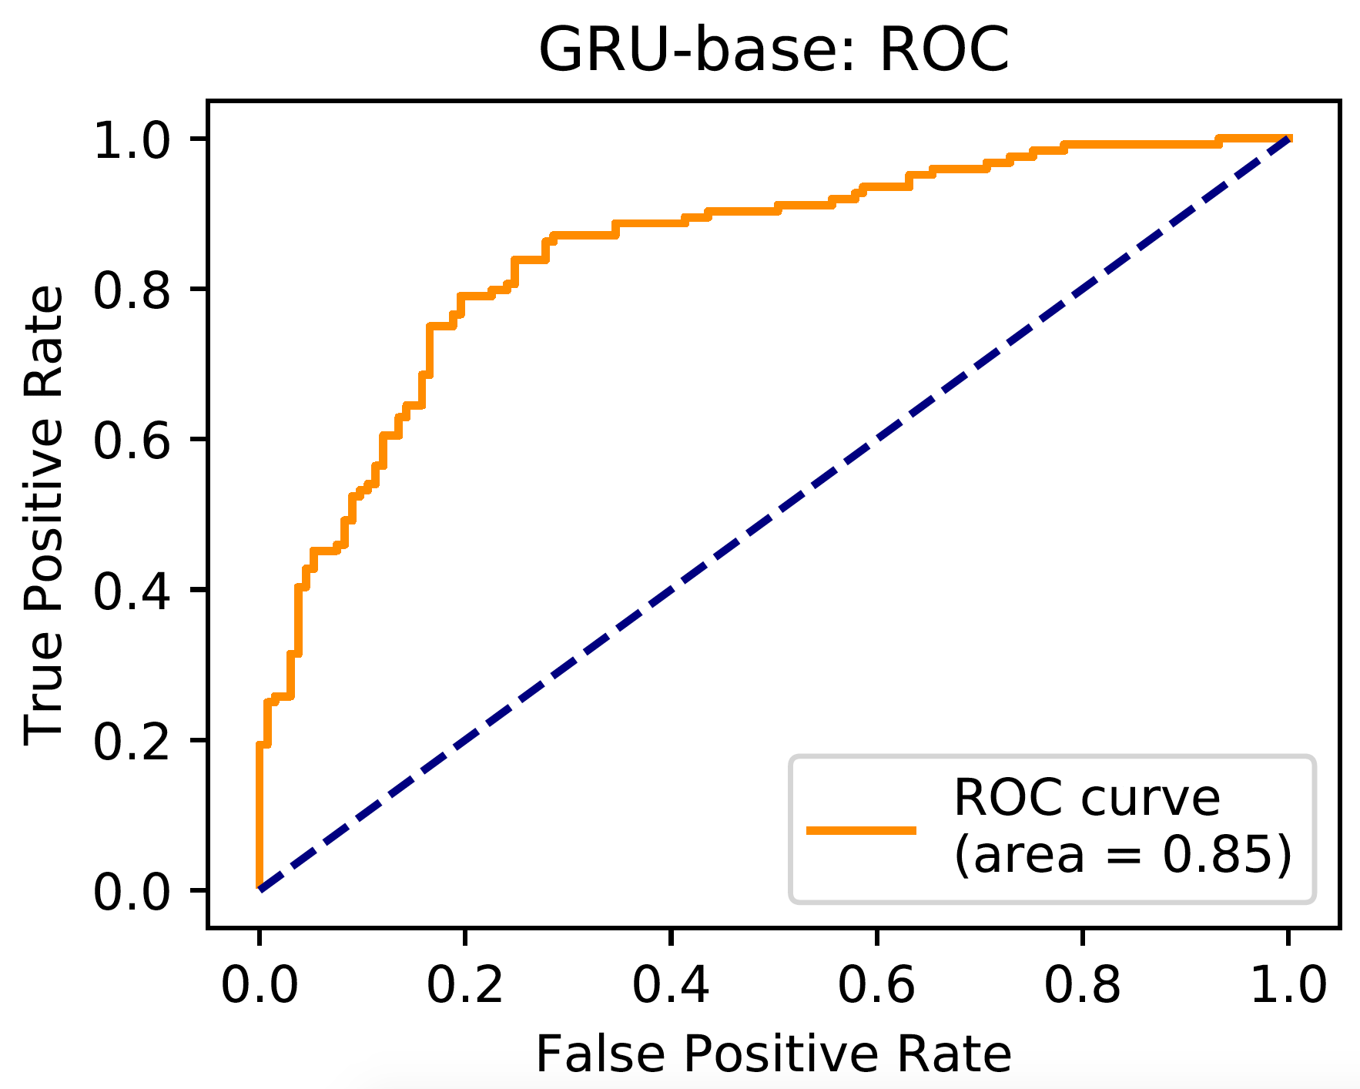
Base Model Results
AUC: 0.85

Slide 40
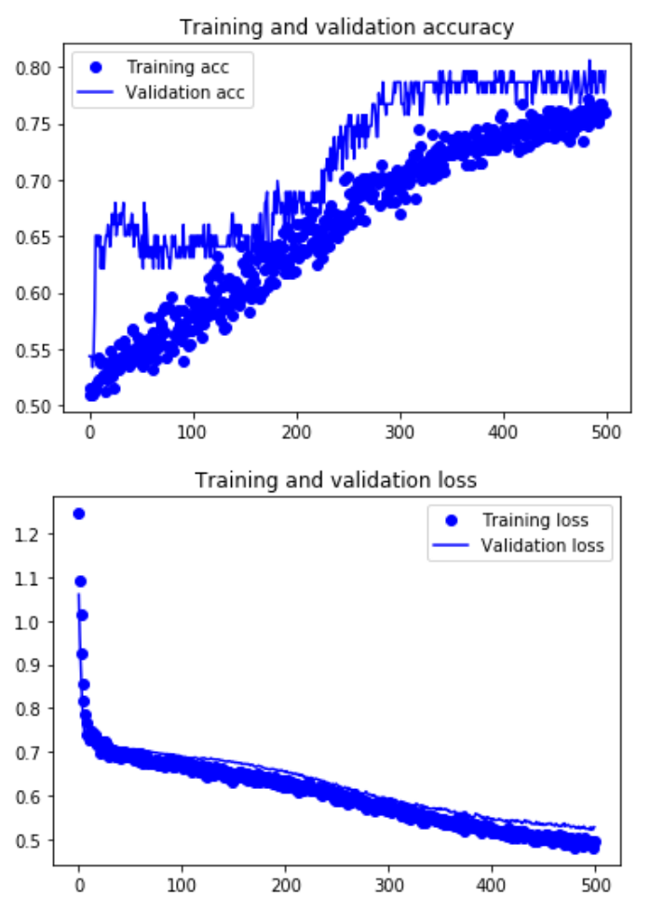
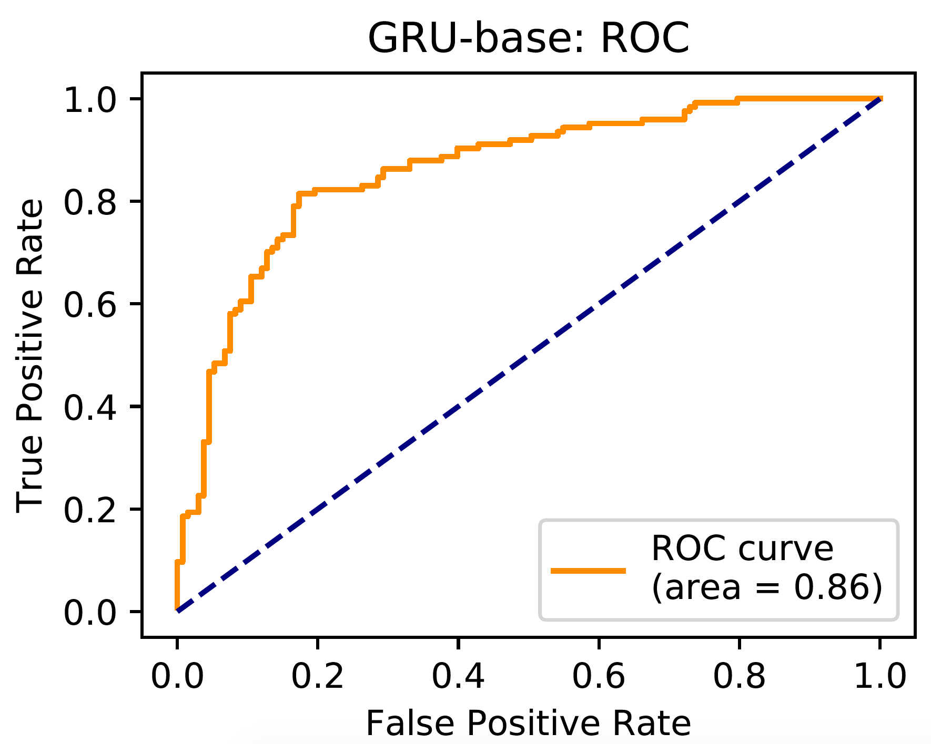
Dropout Model
AUC: 0.86

Slide 41
Conclusion
Surprisingly decent results
We successful built classifiers with good discriminatory capability
We were limited by time and would like to train these models with more complex architecture
Plan to carry project forward and explore other data sources

Slide 42
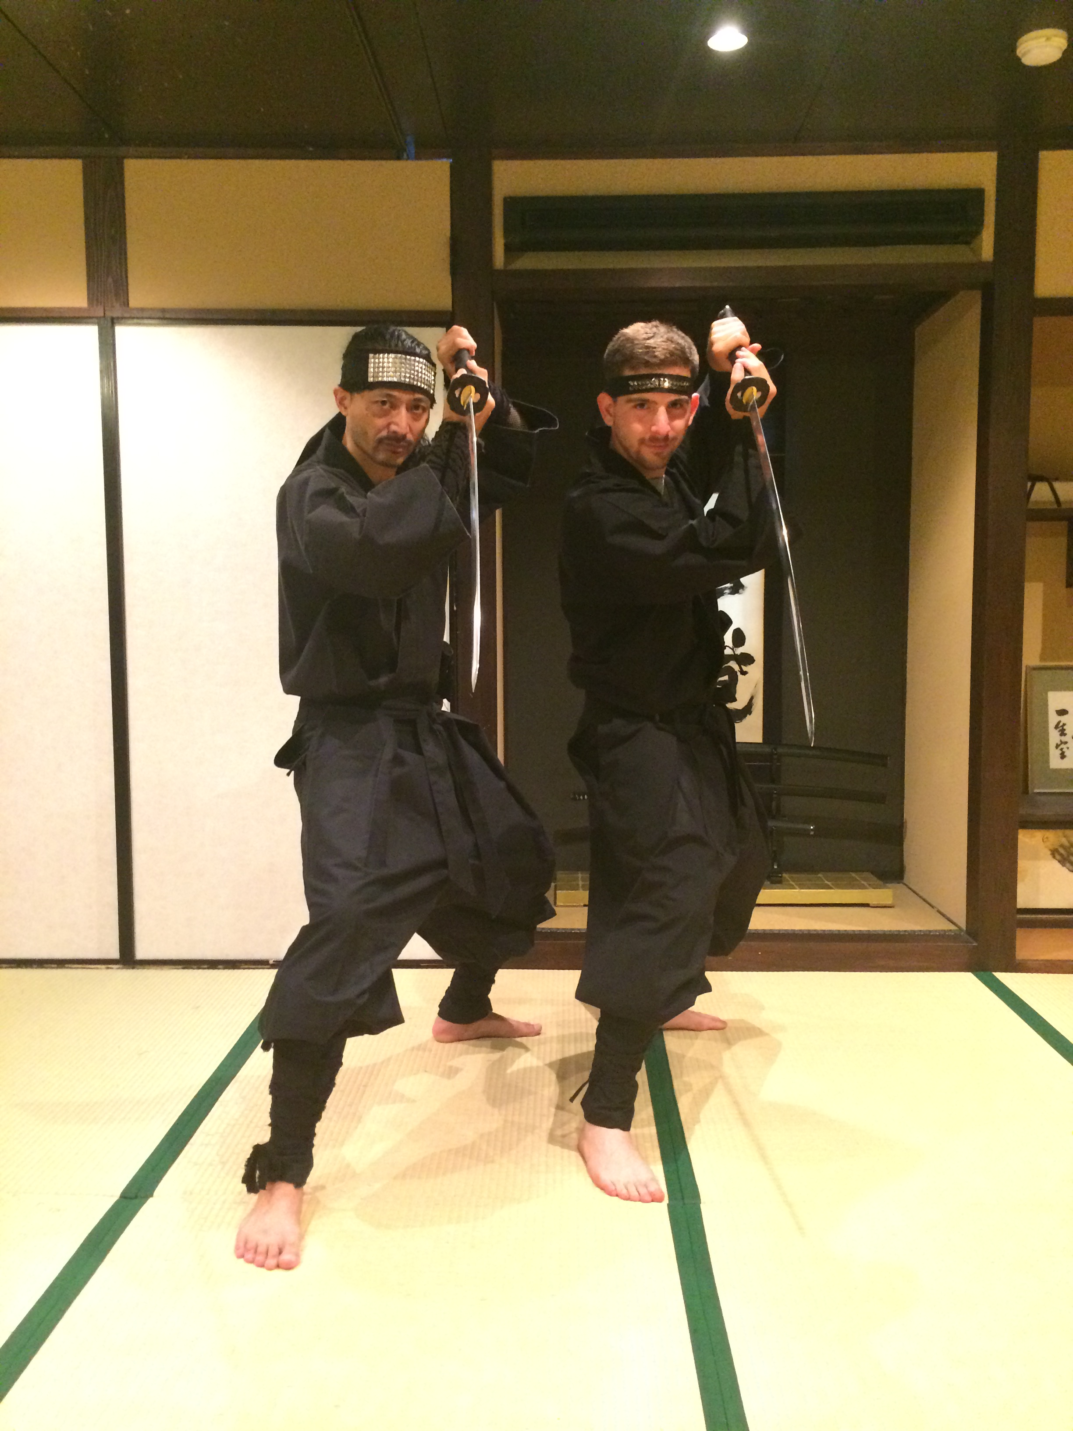
I’m building something!
I had this idea 1 week ago a Japanese ninja dojo
davidsasson.info/start
Social Infrastructure for post-Hackathons
Incubator ?
Non-profit ?
No clue
If you want to get involved or have any cool ideas please get in touch
Developing idea at Harvard Innovation Labs this Fall, launching Jan 2019 (fingers crossed)

